Slide 1

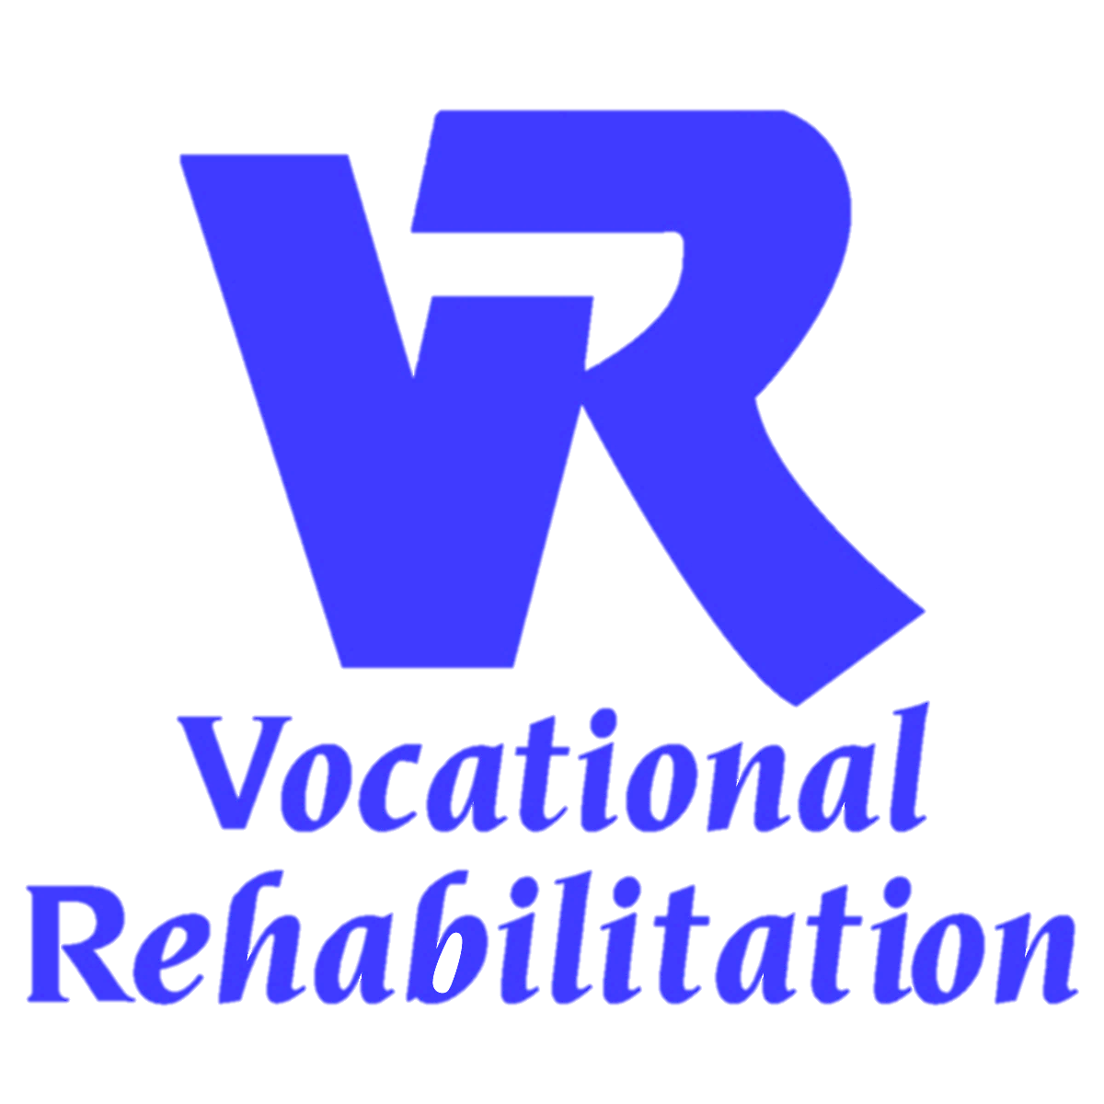
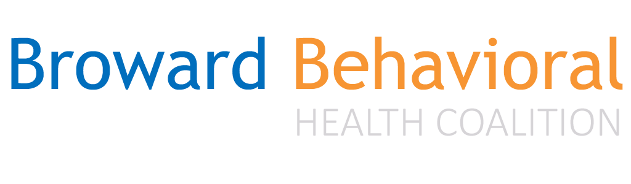
Evidence-Based Supported Employment and Recovery
Presented by: Emery Cowan
Broward Behavioral Health Coalition
Director of Clinical Services, OCP2 Project Director, & IPS Consultant/Trainer

Slide 2
Why Focus on Work?
Most people we serve want to work!
Most see work as an essential part of recovery
Being productive = Basic human need
In most societies, typical adult role
Is integral to community inclusion
Most people we serve live in poverty
Working may prevent entry into disability system
Notes:
Working is often mentioned by people in describing their recovery process. For example:
J. Bailey, “I’m an Ordinary Person,” Psychiatric Rehabilitation Journal, 22, (1998), 8-10.
Rogers, J. A. (1995). Work is key to recovery. Psychosocial Rehabilitation Journal, 18(4), 5-10.
Steele, K., & Berman, C. (2001). The day the voices stopped. New York: Basic Books.
Hierarchy of needs: Maslow, A. H. (1970). Motivation and personality (2nd ed.): Harper & Row.
Working is not the only adult role for adults in our society, but it is clearly very important. It is each client’s choice whether or not he/she would like to pursue work, but mental health centers should make it possible if it is their choice.

Slide 3

Work and Recovery
“Work is commonly viewed by clients as a critical step in the recovery process and because work is broadly considered “normative behavior”, employment has anti-stigmatizing effects on people with severe mental illness”
(McGurk & Mueser, 2003: 789)

Slide 4
Employment Works! IPS Research findings
significant improvement in social skills after 17 weeks of job placement.
employment results in significant symptom improvement and fewer hospitalizations.
participants who were in employment after 18 months tended to have
lower symptoms (particularly thought disorder),
better self esteem and
more satisfaction with their finances and vocational services than those who were unemployed.
being in employment was associated with an increase in independence, an improved sense of self worth and an improved family atmosphere.

Slide 5
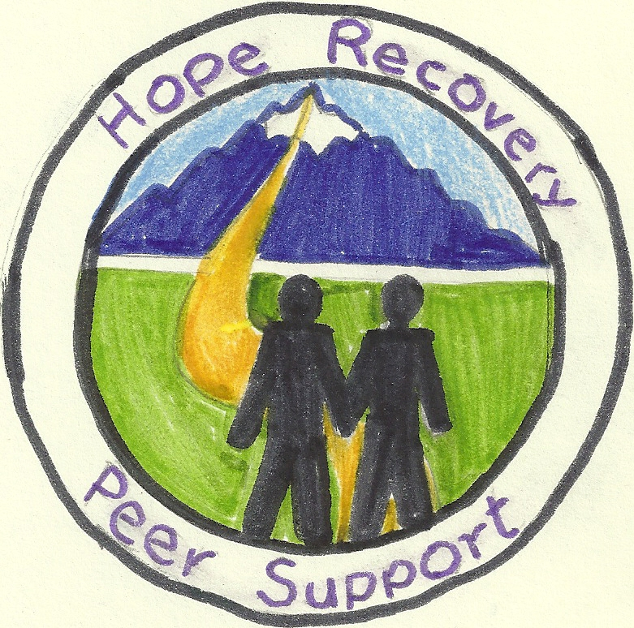
Changing Times
Legal framework for community inclusion
Americans with Disability Act (ADA) & Olmstead Decision
Peer Movement
Consumer advocacy on behalf of self-determination and recovery
Combating Stigma
The impact of discrimination toward those with mental illness, and the role of ‘language’ in alleviating or compounding those problems
http://tucollaborative.org/comm_inclusion/community_integ_intro.html

Slide 6
Changing Landscape
Less focus on pre-vocational or transitional employment – no workshops
Meeting people “where they are”
Using Assertive Engagement skills
Motivational Interviewing
Change talk ---- Because no one changes unless they want to!
Harm Reduction
Employment is the expectation not the exception
Employment is not a charity!
Integration:
Within treatment, services, and collaboration (MH/VR)
Work Readiness is not a factor
Preparedness is key
Employment leads to recovery pathways

Slide 7
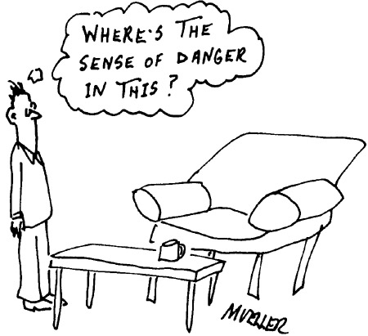
The Dignity of Risk
“We all have value despite where we are on our journey and what challenges we are facing. A job is worth struggling for and worth the risk”
‘Community integration demands that we encourage persons in recovery to expect nothing less than that which individuals living without disabilities look forward to in their lives.’
Managing Risk in Community Integration: Promoting the Dignity of Risk and Supporting Personal Choice http://tucollaborative.org/pdfs/Toolkits_Monographs_Guidebooks/community_inclusion/Managing_Risk_in_CI.pdf

Slide 8
“But work is too stressful”
Stressful compared to what? Try unemployment!
Staying busy and productively occupied should be a basic tenet of mental health care.
It is very difficult to keep your mind off of negatives when you have a lot of time to think, and nothing productive to think about.
Research tells us that…
‘There is a strong evidence base showing that work is generally good for physical and mental well-being.
Unemployment is associated with poorer physical and mental health and well-being.
Work can be therapeutic and can reverse the adverse health effects of unemployment’
(Waddell & Burton, in Freud, 2007: 5)

Slide 9
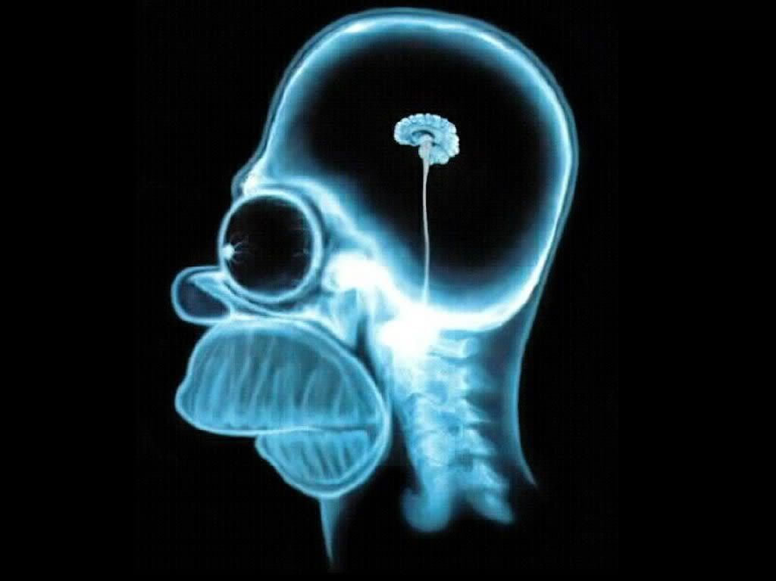
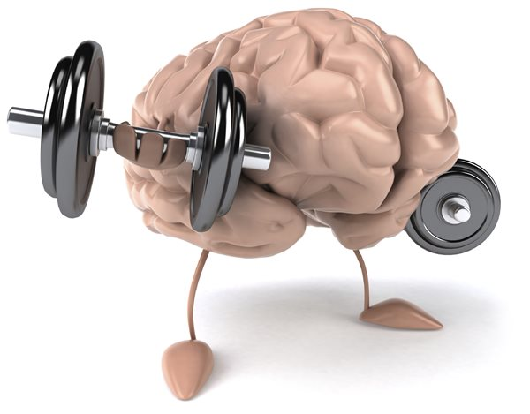
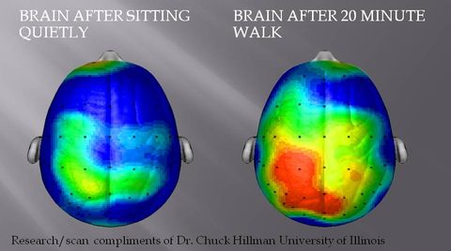
If you don’t use it,
you lose it

Slide 10
“But he/she is too__”…
We need to believe – and expect – that people recover and gain employment
We must encourage curiosity, risk, and change
Research tells us that…
Psychiatric symptoms or diagnosis do not predict vocational rehabilitation outcomes;
Psychiatric symptoms do not correlate with skill level
(Dorio & Marine, 2004: 33)
Psychiatric symptoms, diagnostic category, and standardized psychometric assessments (for example, intelligence or aptitude tests) are poor predictors of future work performance and that there is little or no correlation between a person’s symptoms and functional skills.
(MacDonald-Wilson et al 2001: 222)

Slide 11
“But she/he is not ready”
No one is ever 100% ready
higher expectations for persons we serve
Non-Transferrable skills
On the job training vs. pre-vocational training “groups”
Supported employment is more effective than prevocational training at helping people with severe mental illness obtain competitive employment
“Evidence-based SE specifically has produced consistently better outcomes than traditional vocational rehabilitation in terms of both competitive employment and employment of any type.”
(Crowther, R. E., Marshall, M., Bond, G. R., & Huxley, P. , 2001)
Notes:
If you know you want to be a chef, you have to learn cooking skills – its always job related and educational with an end result
This is different than asking someone “Prove to me you can be compliant and get up on time for 6 months before I refer you to employment” or hanging out in a workshop learning generic work skills that don’t transfer to the job of a chef.

Slide 12

Basic Facts
Desire to work
is a STRONG
predictor!
There are NO predictors of who will be successful
So help everyone get there
And do everything you can to keep them there!
What do employers want?
Someone qualified to do the work
A hardworking, dedicated employee
What do individuals we support want?
To work and live like everyone else

Slide 13
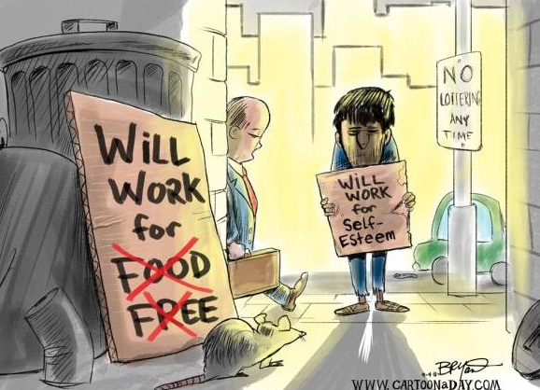
Benefits of Steady Competitive Employment
Improved self esteem
Improved social networks
Increased quality of life
Reduced psychiatric symptoms
Reduced substance use
Less use of disability system
Arns, 1993, 1995; Barreira, 2011; Bond, 2001; Burns, 2009;Drake, in press: Fabian, 1992; Krupa, 2012; Kukla, 2012; McHugo, 2012; Mueser, 1997; Van Dongen, 1996, 1998; Xie, 2005
Notes:
Rogers, J. A. (1995). Work is key to recovery. Psychosocial Rehabilitation Journal, 18(4), 5-10.
…Working is transformative
Sources: Arns, 1993, 1995; Bond, 2001; Fabian, 1989, 1992; Mueser, 1997; Van Dongen, 1996, 1998

Slide 14
Role of Work in Recovery Process: Work is the best treatment we have

Slide 15

Individual Placement and Support Model of Supported Employment
The Evidence Based Practice

Slide 16

Evidence-Based SE is referred to as…
INDIVIDUAL PLACEMENT AND SUPPORT
the evidence-based approach to supported employment for people who have a severe mental illness and co-occurring disorders.
Developed by the Dartmouth Psychiatric Research Center - Dartmouth College School of Medicine in New Hampshire
IPS was first studied in a randomized controlled trial in 1996
IPS has been evaluated in 22 randomized controlled trials. This research has established IPS as an evidence-based practice
Approved by SAMHSA
www.IPSWORKS.org

Slide 17
Making the Case
IPS works!
3 x’s more effective than other vocational approaches
effective for numerous populations
IPS is cost-effective
Once on the disability rolls, less than 1% of beneficiaries per year move off of benefits to return to work.
IPS is an excellent investment, with an annual cost of $5500 per client in 2012 dollars.
average annual savings of over $16,000 per client in mental health treatment costs for steady workers, compared to clients not working
IPS improves long-term well-being.
Approximately 40% of clients who obtain a job with help from IPS become steady workers and remain competitively employed a decade later
IPS programs have a high rate of successful implementation and sustainability over time
Programs ordinarily achieve high fidelity implementation within one year’s time.
High fidelity IPS programs have better competitive employment outcomes
IPS has been successfully implemented in both urban and rural communities

Slide 18
The Gap Between Need and Access
2/3 want to work
Yet only 1%-2% have access to effective employment services
15% employed at any time
That is an 85% national unemployment rate for people with MH!
Florida average is 84.7% who don’t work!
NAMI (2014) “Road to Recovery: Employment and Mental Illness” http://www2.nami.org/Template.cfm?Section=Policy_Reports&Template=/ContentManagement/ContentDisplay.cfm&ContentID=169263

Slide 19
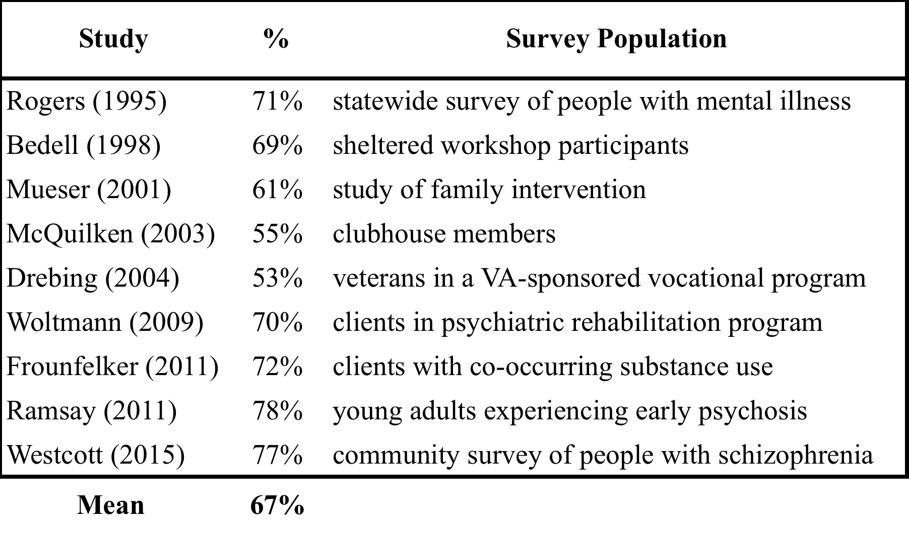
Expressed Interest in Employment
Reported in 9 Surveys

Slide 20
Overall Findings for 22 RCTs
All 22 studies showed a significant advantage for IPS
Mean competitive employment rates for the 22 studies:
56% for IPS
23% for controls

Slide 21

20 Randomized Controlled Trials (RCTs) of Individual Placement and Support (IPS)
Best evidence available on effectiveness
RCTs are gold standard in medical research:
Random assignment = Participants assigned by a flip of a coin

Slide 22
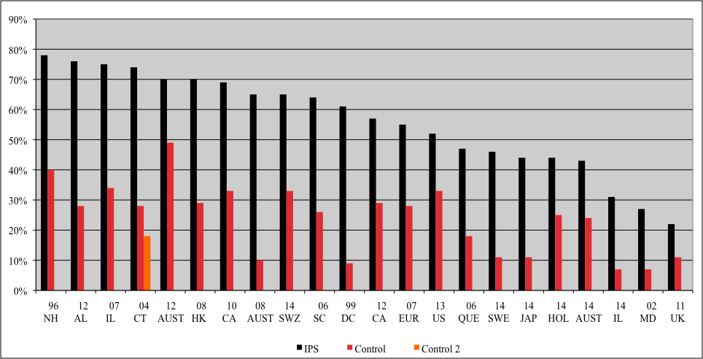
Competitive Employment Rates in 22 Randomized Controlled Trials

Slide 23
18-Month Competitive Employment Outcomes in 4 Controlled Trials of IPS
(Bond, Campbell, & Drake, 2012)

Slide 24

Program Model

Slide 25
Traditional → IPS Assumptions Assumptions

Slide 26
The Eight Practice Principles of IPS
Zero exclusion criteria
Client preferences are important
Benefits planning is offered to all
The focus is on competitive jobs
Supported employment services and mental health services are integrated
Rapid job search
Employment specialists build relationships with employers
Follow-along supports are continuous

Slide 27

1. Zero Exclusion
Rationale
Eligibility Based on Client Choice
IPS supported employment practitioners need to be advocates for people
When the IPS model is in place, case managers and employment specialists don't discourage people from working based on any of these factors→
Psychiatric diagnosis
Symptoms
Treatment choices
Work history
Substance use
Cognitive impairment
Missed appointments with mental health team
Grooming
Legal history
Medication
“non-compliance”

Slide 28

2. Attention to Client Preferences
This is the principle that trumps all others--- IPS supported employment is about empowering people to have more choices and options in their lives. Even the way that services are provided should be based upon client preferences
Client preferences strongly influence:
type of job that is sought,
nature of the support provided
decisions about disclosing one's disability to the employer

Slide 29
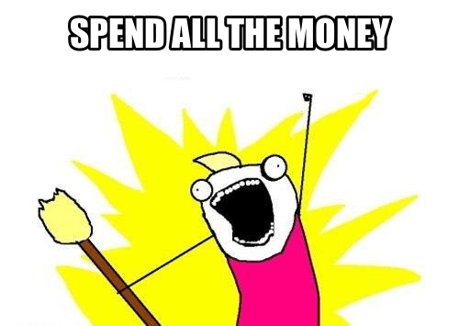
3. Benefit Planning
Every person should have accurate information about benefits and work incentives
Referrals to benefits counselors as needed
Many things can affect net income; should be discussed at engagement and ongoing
SOAR case workers can support an IPS Team with Work Incentives

Slide 30

4. Competitive Employment
Regular jobs in the community rather than jobs that are set aside for people with disabilities
Part-time or full-time
pay at least minimum wage
don't include artificial time limits
have the same pay and benefits for everyone who holds those positions
Temporary/Seasonal jobs do count
Volunteering ok only if actively seeking work in meantime
Supported Education included

Slide 31

5. Integration with Behavioral Health Treatment Services
Frequent communication between SE/BH team members is critical
All of the people working with a person function as a team
All meet at least once a week to discuss the best strategies to help people attain their goals
Team members also touch base with each other between meetings for quick updates and problem solving sessions
The treatment team shares ideas with the client who will make the final decision
Most often, SE and BH staff share office space!

Slide 32

6. Rapid Job Search
It demonstrates that practitioners
Are taking their client's goals seriously
believe that their people have strengths and skills to take to the job
For some people, there is a 'window of opportunity' when it comes to going back to work
Quickly exploring jobs in the community is one way to take advantage of that motivation: people get excited as they see the possibilities

Slide 33
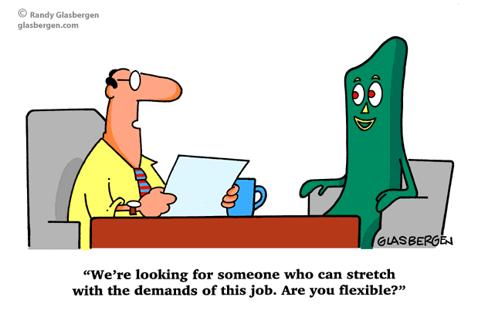
7. Systematic Job Development
Employment specialists
build an employer network based on people’ interests,
develop relationships with local employers by making regular contacts.
visit employers to schedule appointments,
learn more about the needs and preferences of those employers and only then may decide to talk about a person whom they believe to be a good fit for that business

Slide 34

8. Long Term Job Supports
Individualized assistance to working people is available as long as needed and desired
Although employment specialists provide many of the follow-along supports needed, case managers or therapists can also help out
Family members and friends can be a part of this support if so requested
It is important not to transfer a
working client off of the IPS team
too quickly

Slide 35

IPS Team
INDIVIDUAL
DVR liaison
IPS TEAM- or “vocational unit”
Team Leader and 2 employment specialists
BEHAVIORAL HEALTH STAFF- therapist, case manager, doctor, nurse…etc.
Meet weekly
Meet weekly

Slide 36
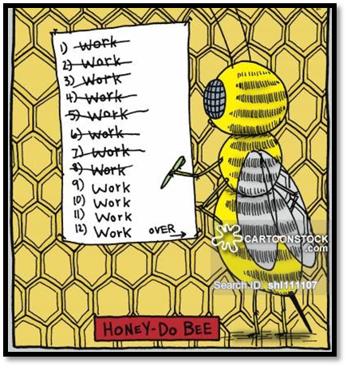
Program Structure
It’s the entire IPS program’s responsibility to keep an eye open for job leads
Cross-training among agency staff
Team members communicate often so that everyone is on the same page
The IPS team meets weekly to share job leads, celebrate successes and brainstorm strategies

Slide 37
IPS & VR
A federal partner as expert in employment services and financing of supports
Both State and local MH and VR offices develop shared responsibilities:
Examine and modify VR regulations and guidelines that conflict with IPS principles
Some cites write MOUs
Revise policies when working with IPS and population (i.e., documentation, evidence gathering, referrals)
Some key differences in approach:
fast access to employment specialist
no supplemental/on-site assessments
simpler documentation for vocational assessment (Career Profile)
rapid job search (30-day window to begin looking for work)
early benefits counseling for all.
http://www.ncbi.nlm.nih.gov/pubmed/23477643

Slide 38
IPS & VR
Collaboration between IPS agency and VR offices
VR assigns liaison to agency- becomes a subject matter expert in mental health and IPS
VR is integrated and attends regular face to face meetings- sometimes share offices (where clients are)
Discuss shared caseloads (who will VR open, close, etc)
IPS agency provides immediate behavioral health interventions - VR counselors often do not have access to such supports
VR has higher success rate in closures and job retention long term
http://www.dartmouthips.org/resources/vocational-rehabilitation/

Slide 39
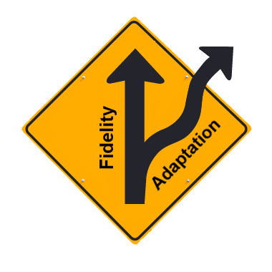
Implementation & Program Fidelity
What is it & why does it matter?
Notes:
39
39
39

Slide 40
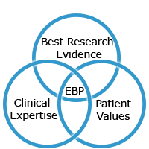
Program Fidelity
What is an Evidence-Based Practice (EBP)?
What is Fidelity?
Based in theory and has undergone scientific research & evaluation, replication, and
Supported by:
Implementation manual
Fidelity Scale measurement tool
Trained Evaluators/Trainers
The degree to which a program includes features that are critical to achieving the intended outcomes
Program fidelity is positively correlated with improved outcomes and cost-effectiveness
Measured through detailed 2-day qualitative and quantitative reviews and report

Slide 41
SE Fidelity Program Resources
Tools
Scale
SE Fidelity Scale http://www.dartmouthips.org/wp-content/uploads/2014/04/IPS-Fidelity-Scale-Eng1.pdf
Fidelity Review Manual
http://www.dartmouthips.org/wp-content/uploads/2014/11/fidelity-review-manual-chaptersrevised.pdf
25 items on a 5-point anchored scale
3 subscales: Staffing, Organization, Services
Item total scores are added up:
115-125 = Exemplary Fidelity
100-114 = Good Fidelity
74-99 = Fair Fidelity
73 and below = Not Supported Employment

Slide 42
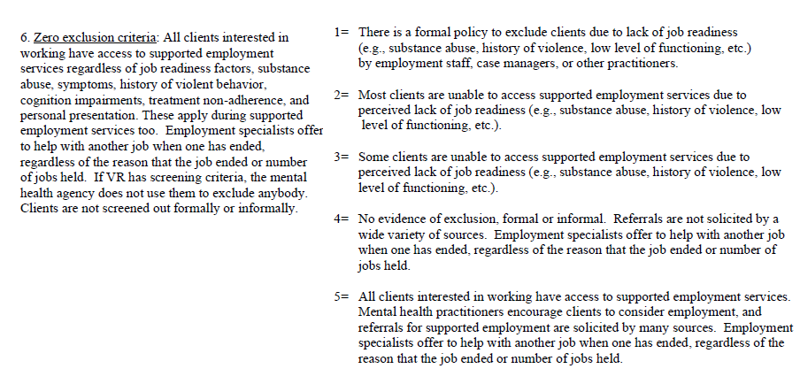
Example: Scale Item 6, Organization

Slide 43
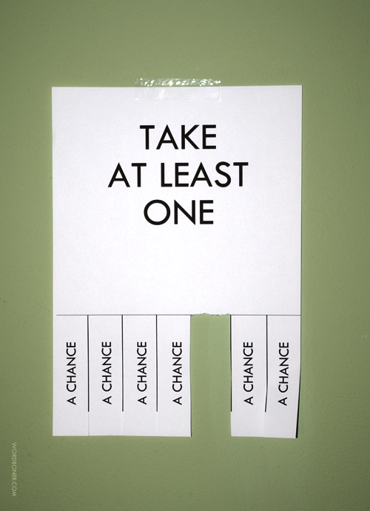
Conclusions
Employment is a pathway to recovery
Reluctance to change is not resistance
Believe people can work in the community
IPS is the best researched program to achieve this goal
States/Localities invest in change!
Learning collaborative local, statewide and with Dartmouth is the best way to implement IPS widely

Slide 44
Questions?
Emery Cowan, MS, LMHC, LPC, CESP
Project Director, One Community Partnership 2
Broward Behavioral Health Coalition
1715 SE 4th Avenue, Fort Lauderdale, FL 33316
Main: (954) 622-8121, x.1020
Cel: (954) 560-1151
ecowan@bbhcflorida.org
IPS WEBSITE
www.IPSWORKS.org

